Slide 1
Fabian Wolf
G11N, I18N, L10N an introduction
05.10.2018

Slide 2
What is Globalization?

Slide 3

Globalization (G11N):
All activities carried on by an enterprise regard-ing commercialization of a Software product in non national or local markets

Slide 4
Internationalization (I18N):
Engineering Software in a way, making it adapt-able to other markets fast and simple

Slide 5
Localization (L10N):
The actual process of adapting a software pro-duct to regional markets.

Slide 6
Why is this relevant for Movilizer?

Slide 7
BAT
Movilizer
LSP

Slide 8
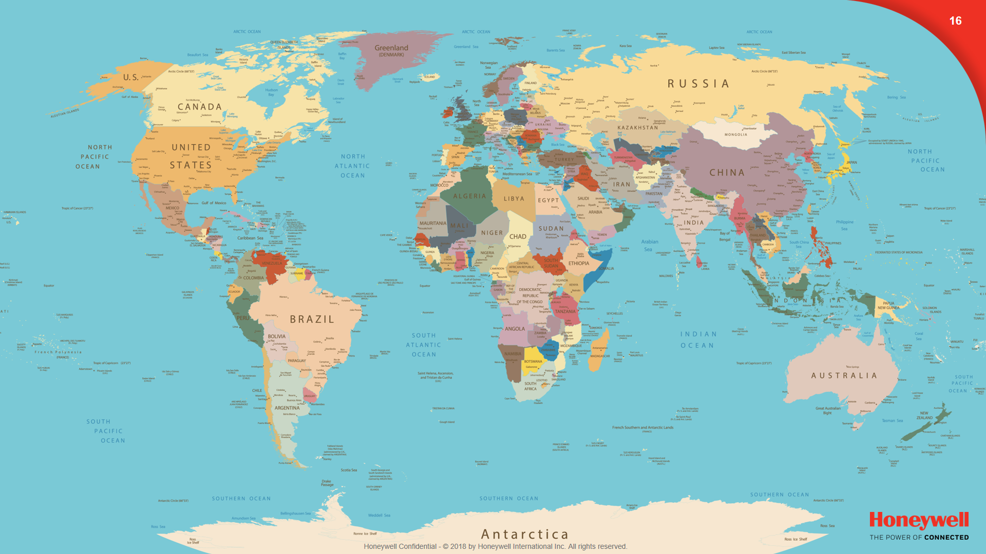

Slide 9
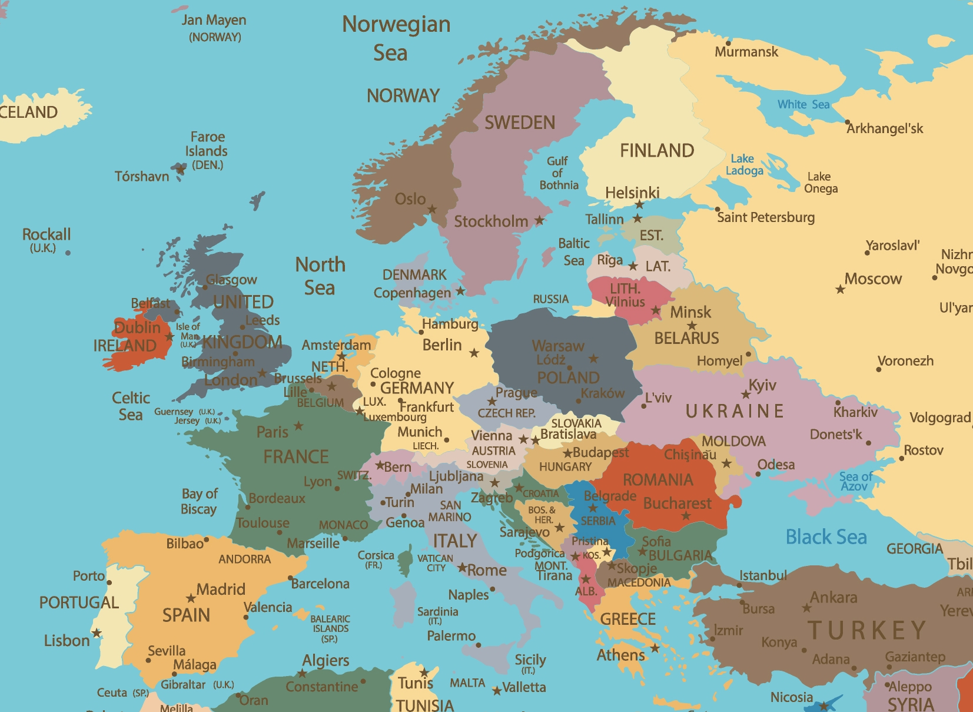

Slide 10
Sourcestring | Targetstring
Hello %name% | %name% adilo
%age% is old | Na %age% des

Slide 13
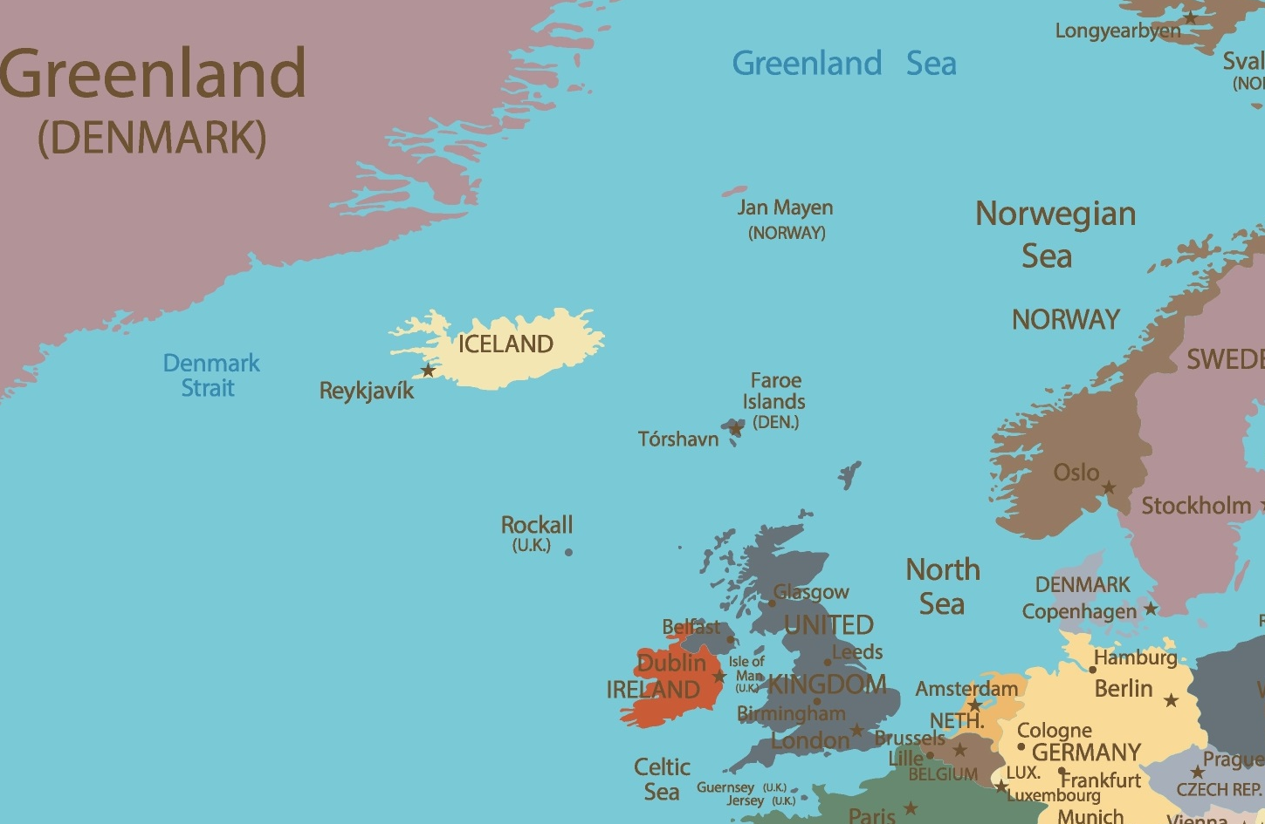

Slide 14
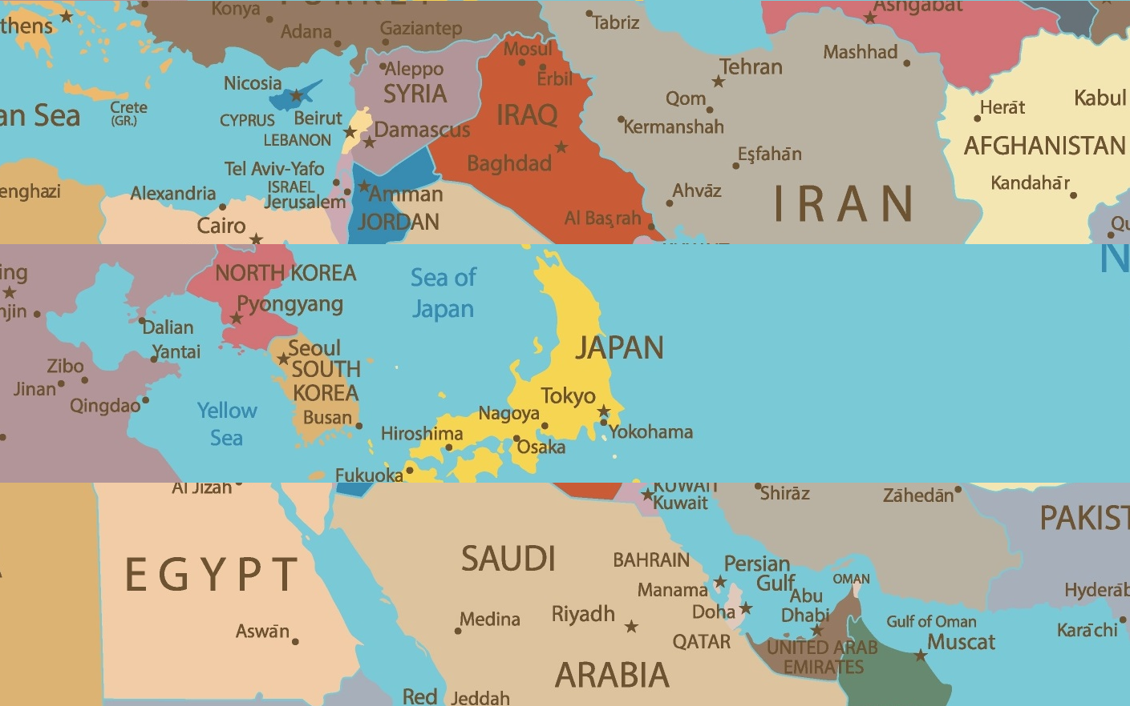

Slide 16

UNIX Time
Timeshift
CEST
UTC
Gregorian Calendar
Leapsecond
GMT +10
Julian Calendar

Slide 17



OK
%$&?!§

Slide 18


OK
%$&?!§

Slide 19
“(…) Provision should, therefore, be made for unit packets of tobacco products to be marked with a uni-que identifier and security features and for their move-ments to be recorded so that such products can be tracked and traced throughout the Union (…)”

Slide 20
What is the Key Message?

Slide 21
How can we make Localization less pain in the Ass?

Slide 22




Extract from
the code
Translate /
Store
Reinject in
the code

Slide 23
Mark up (ITS, gettext)
Semantic / syntactic parsing
Ressource Files

Slide 24
Human Translation
Computer Aided Translation
Computer Translation
In Place Localisation

Slide 25
Translation Memory
Terminology Database

Slide 26
GMX
SRX
TMX
XLIFF
Gettext PO
XML:TM
TransWS
UTX
TBX
MARTIF
OLIF

Slide 27
Each tool has its own way

Slide 28
Localization Tool

Slide 29
Extract from
the code
Translate /
Store
Reinject in
the code

Slide 30
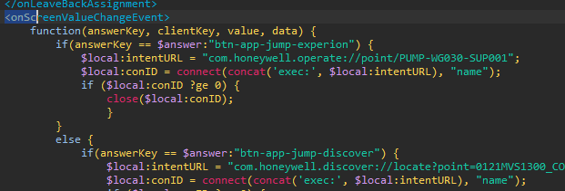
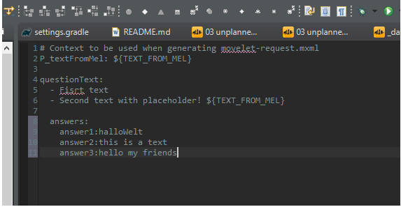
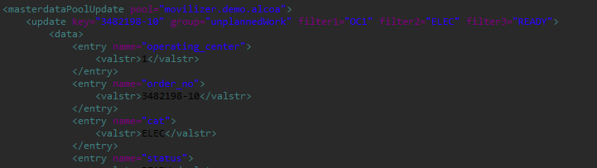
XML Element Content
XML Attribute Values
Literals in MEL and Gradle Ressource Files

Slide 31
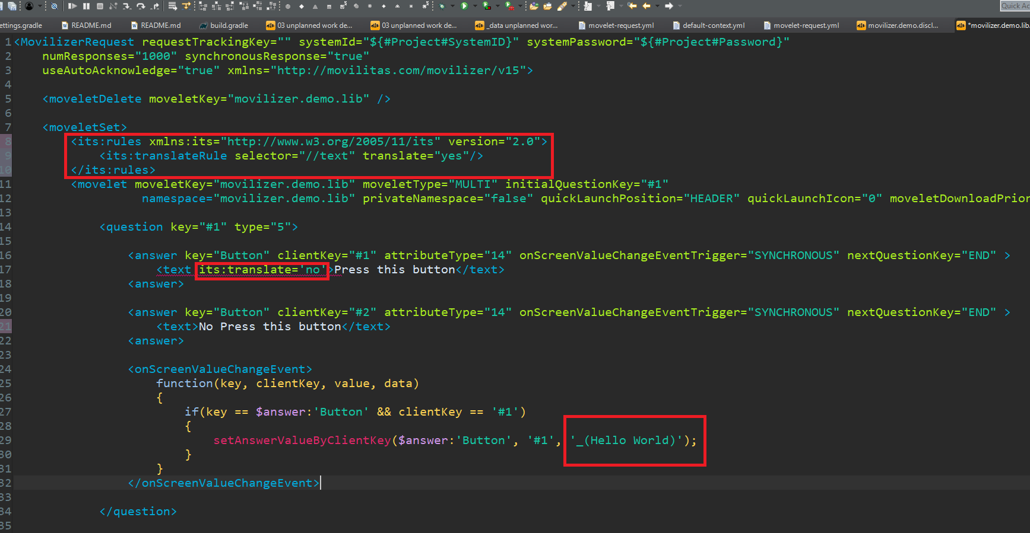

Slide 32



Database
MXMK
XLIFF
Contractor
Code
Interchange Format
Translationtool

Slide 33
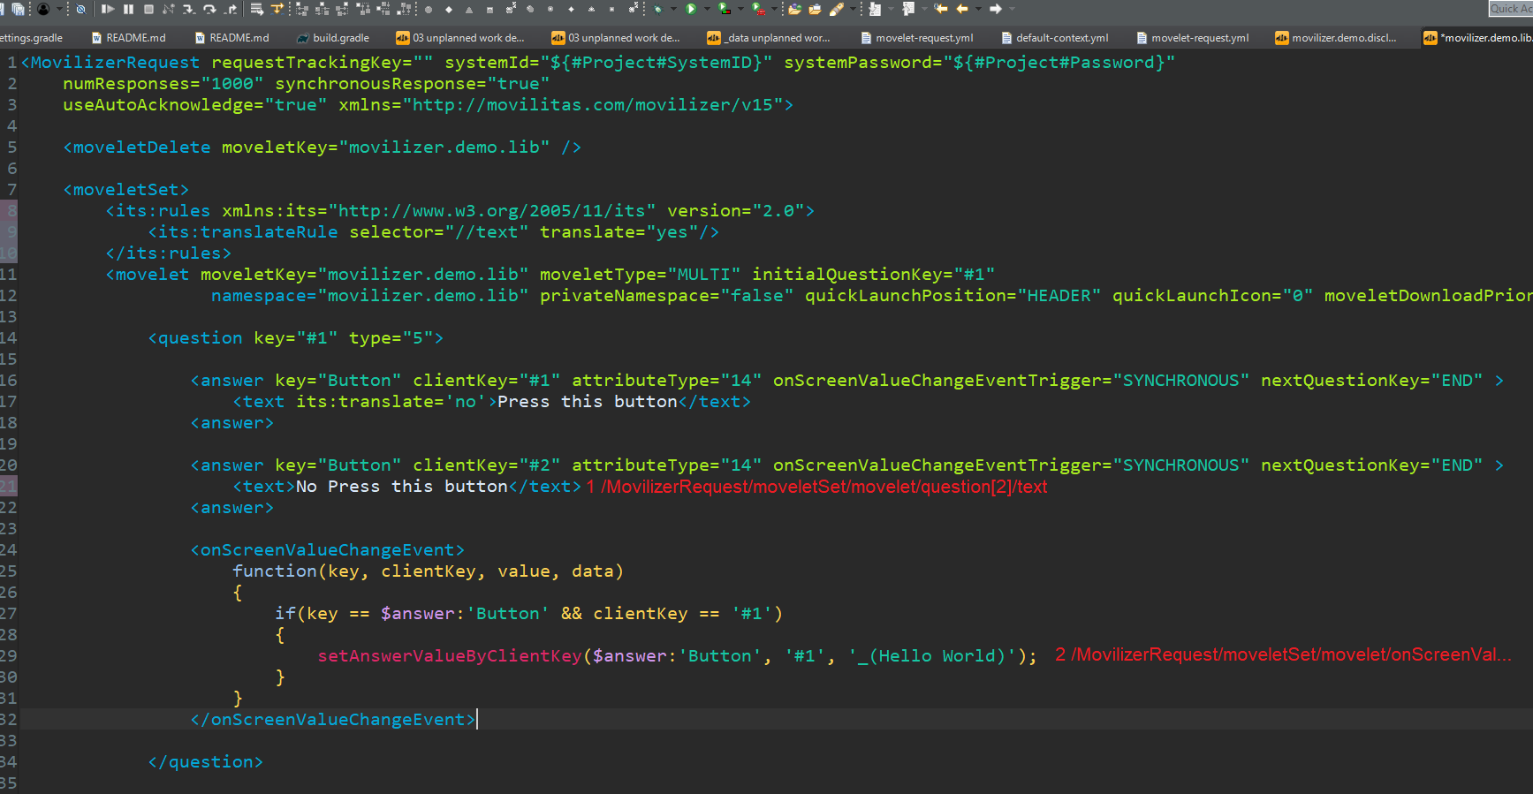

Slide 34
<text its:translate='yes' xmld:id='1'>
This is my String
</text>
<text its:translate='yes' xml:id=‚'2'>
This is my String
</text>
_('This is my String', xml:id=‚3')
_('This is my String', xml:id =‚4')

Slide 35
Call for Participation

Slide 36
Fabian Wolf
Workin Student, Movilizer GmbH
Phone +49 6218545 x 0266
E-Mail fabian.wolf@honeywell.com
Web movilizer.com
Movilizer GmbH Konrad-Zuse-Ring 30 D-68163 Mannheim, Germany
The contents of this presentation are the intellectual property of Honeywell International, Inc. Any other use as well as disclosure to third parties in the original, in a copy, in part, electronically or by similar content requires the approval of the company.
Thank You for Your Attention!

